Slide 1

Forecasting Response Time for Service Requests in NYC
By Joseph Majdalani
Notes:
To change the image on this slide, select the picture and delete it. Then click the Pictures icon in the placeholder to insert your own image.

Slide 2
Agenda
Business Understanding
Data Understanding
Data Preparation
Modelling
Validation
Objective
Data Understanding
Data Preparation
Modeling and Evaluation
Model Optimization

Slide 3
Objective
NYC service requests can have a response time ranging from 1 day to several years.
Forecasting response time can lead to proactive resource allocation and better operational efficiency.
This leads to better service quality and customer satisfaction.
The objective is to build a predictive model that can leverage machine learning to forecast service response time.

Slide 4
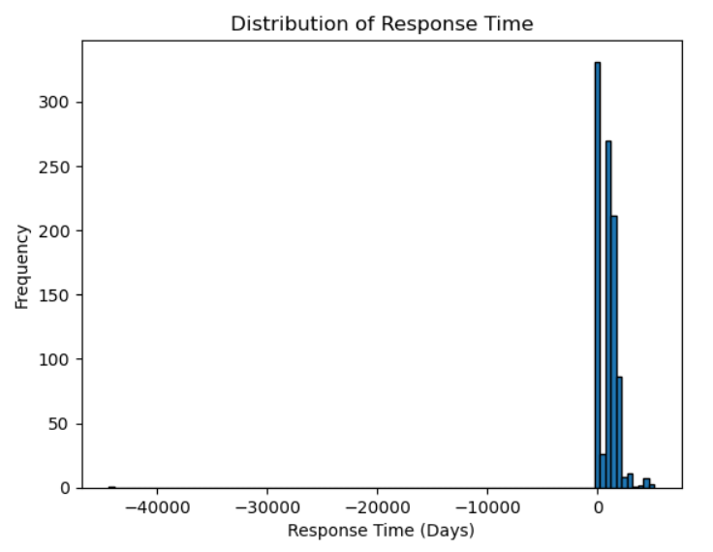
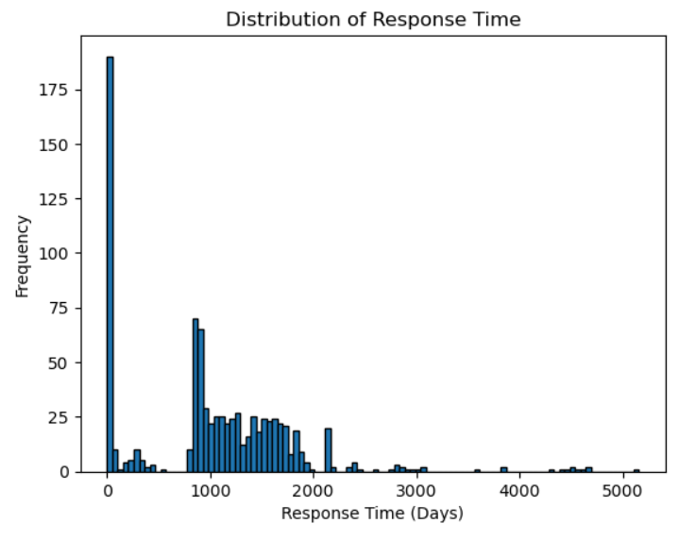
Data Understanding
Analyzed service request created date and end date.
Created a new feature response time in days.
Analyzed the distribution before and after removing outliers and cancelled requests.

Slide 5
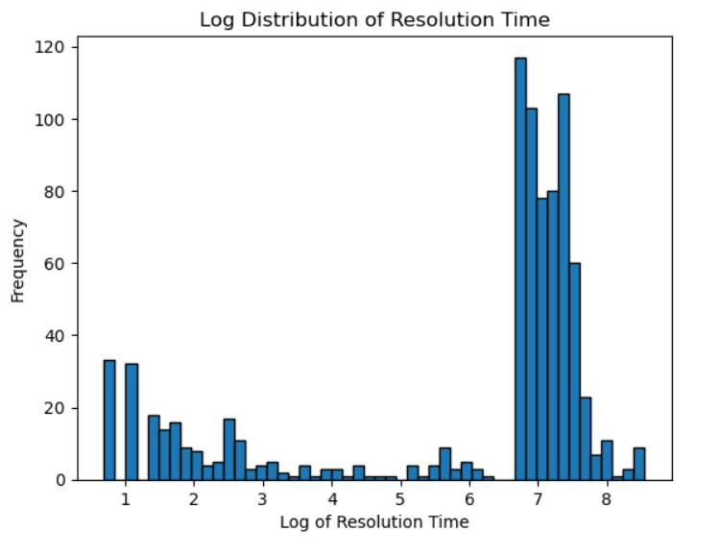
Data Understanding
Analyzed the logarithm of service response times.
The log plot shows 2 primary clusters: short-term and long-term response times.
Some complaints are resolved quickly (in days), while others take much longer (several years).

Slide 6
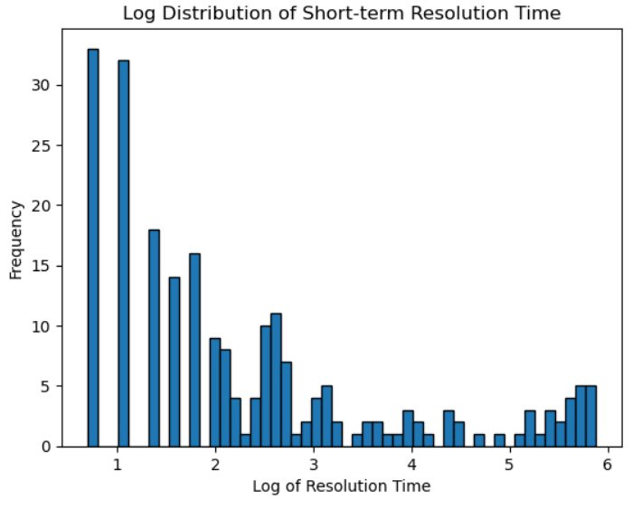
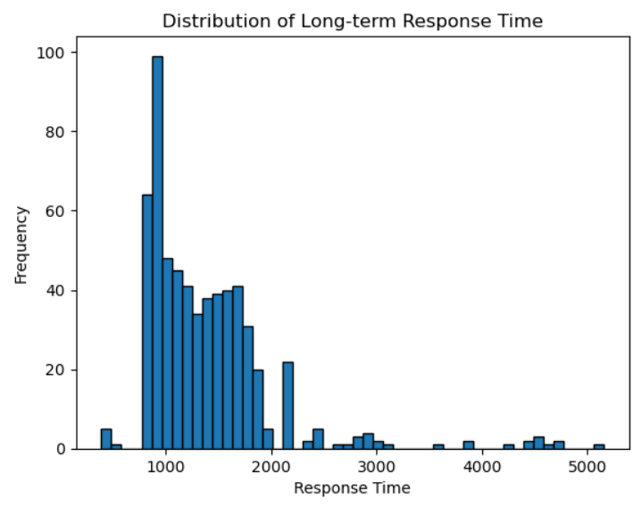
Data Understanding
Split the service responses into short-term and long-term categories.
The log-scale plots show a more gaussian-like shape.
The number of requests in both short-term and long-term clusters is too small to train effective, separate models.

Slide 7
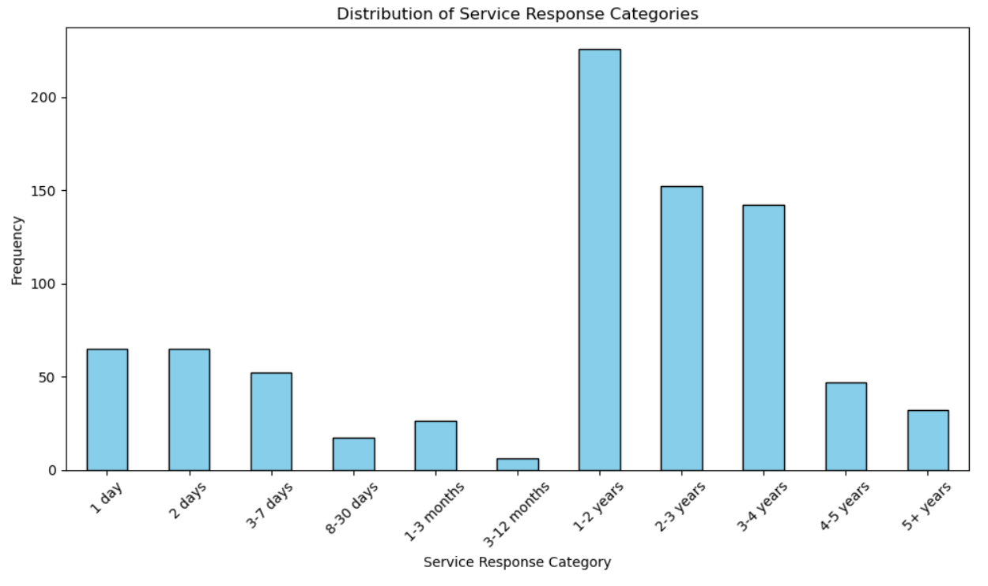
Data Preparation
Split the service responses into 11 categories.
Transformed the regression problem into classification.
The result is a simpler categorization of resolution times.

Slide 8
Data Preparation
Engineered three key features that provide critical context and improve model accuracy.
Season: Captures the time of year when the service is requested.
Weather: Captures the worst-case weather conditions on the day of service creation or the following day.
Number of open service requests: Reflects the number of active requests per agency at the time of service creation.

Slide 9
Data Preparation
Imputed missing values for city from the borough as well as from Google Maps by navigating to the coordinates.
Removed service requests with missing city, coordinates, and borough as they have a lot of missing information.
Merged complaint types which mean the same thing (e.g. Dirty Condition and Dirty Conditions.
Imputed missing fields in features such as street, intersection, landmark with “Unspecified” to avoid having null values in the data.
Ignored features that are not expected to be available when a new service request in created (e.g. resolution description, status).

Slide 10
Data Preparation
All categorical features were one hot encoded into binary features, one for each unique value.
The number of open service requests per agency (ordinal) was scaled using standard scalar
The dataset was split into train and test partitions to evaluate the generalized model performance on unseen data.
Stratified split was used to maintain equal proportions of all response time categories in both partitions.

Slide 11
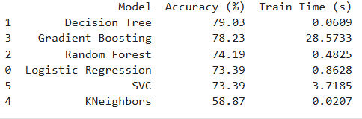
Model Evaluation
Tested 6 multi-class models.
Evaluated model predictive performance based on accuracy %.
Decision Tree model outperformed all other models in accuracy and efficiency (lowest time to train a model).
Decision Tree can capture non-linear relationships effectively and ignore features with low predictive performance.

Slide 12
Model Optimization
Applied grid search to optimize key hyperparameters.
Tuned parameters such as maximum tree depth, minimum sample splits, and minimum sample leaf.
Decision Tree best parameters include a maximum depth of 15, which ensures generalized performance and no overfitting.
Decision Tree accuracy on the test partition after parameter optimization reached 81.45%.

Slide 13
Thank You

